Slide 1
Crossed Lines
Don Steward

Slide 2
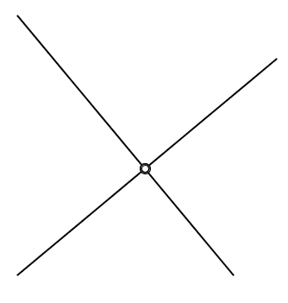
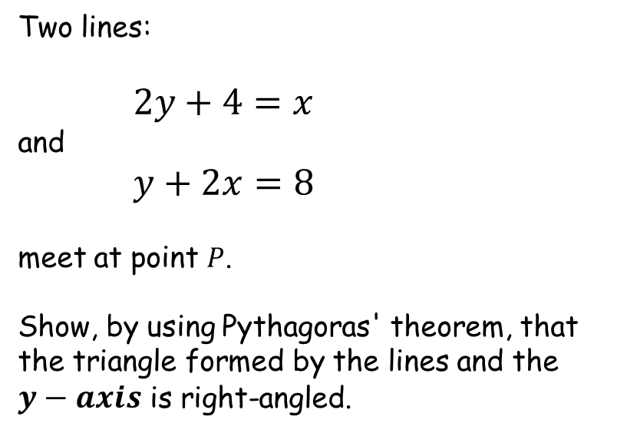

Crossed Lines
Two lines:
$2y+4=x$
and
$y+2x=8$
meet at point $P$.
Show, by using Pythagoras' theorem, that the triangle formed by the lines and the $y−axis$ is right-angled.
$$P$$

Slide 3
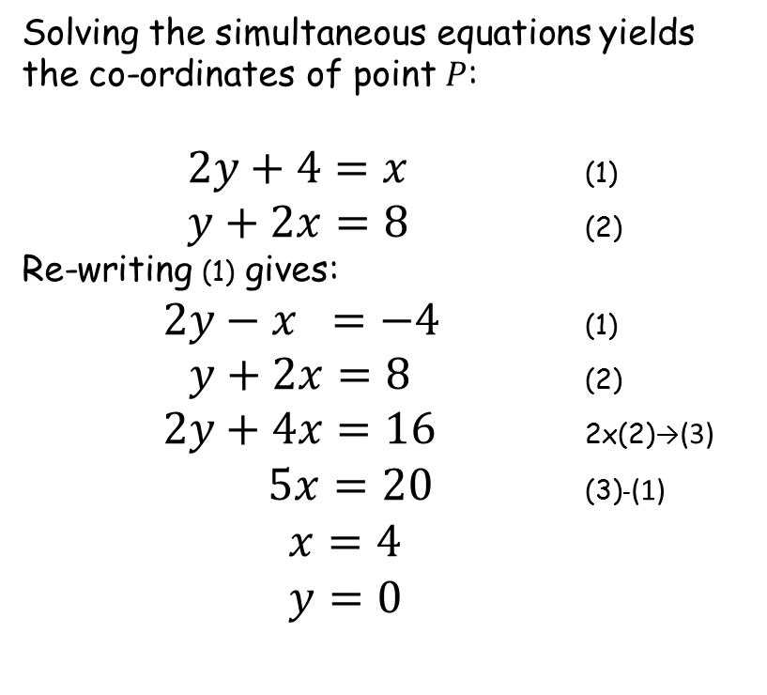



Crossed Lines
Solving the simultaneous equations yields the co-ordinates of point $P$:
$2y+4=x$ (1)
$y+2x=8$ (2)
Re-writing (1) gives:
$2y−x =−4$ (1)
$y+2x=8$ (2)
$2y+4x=16$ 2x(2)→(3)
$5x=20$ (3)-(1)
$x=4$
$y=0$
$$y+2x=8$$
$$P$$
$$\left(4,0\right)$$
$$2y+4=x$$

Slide 4

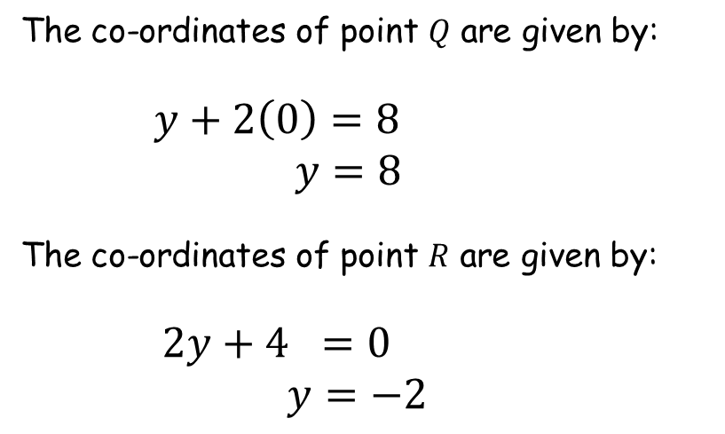





Crossed Lines
$$y$$
The co-ordinates of point $Q$ are given by:
$y+2\left(0\right)=8$
$y=8$
The co-ordinates of point $R$ are given by:
$2y+4 =0$
$y=−2$
$$Q$$
$$\left(0,8\right)$$
$$y+2x=8$$
$$P$$
$$x$$
$$\left(4,0\right)$$
$$R$$
$$2y+4=x$$
$$\left(0,−2\right)$$

Slide 5





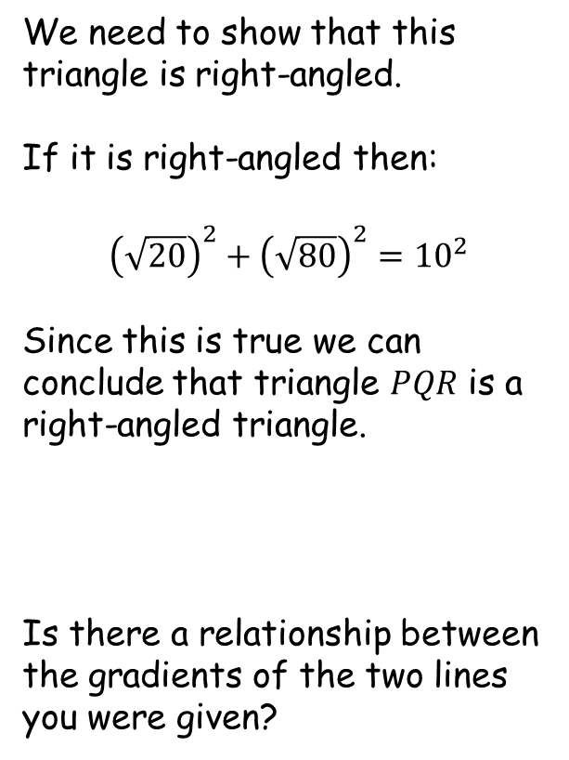








Crossed Lines
$$Q$$
$$\left(0,8\right)$$
We need to show that this triangle is right-angled.
If it is right-angled then:
$${\left(\sqrt{20}\right)}^{2}+{\left(\sqrt{80}\right)}^{2}={10}^{2}$$
Since this is true we can conclude that triangle $PQR$ is a right-angled triangle.
Is there a relationship between the gradients of the two lines you were given?
$$4$$
$$\sqrt{80}$$
$$8$$
$$10$$
$$P$$
$$\left(4,0\right)$$
$$\sqrt{20}$$
$$2$$
$$4$$
$$R$$
$$\left(0,−2\right)$$

Slide 6
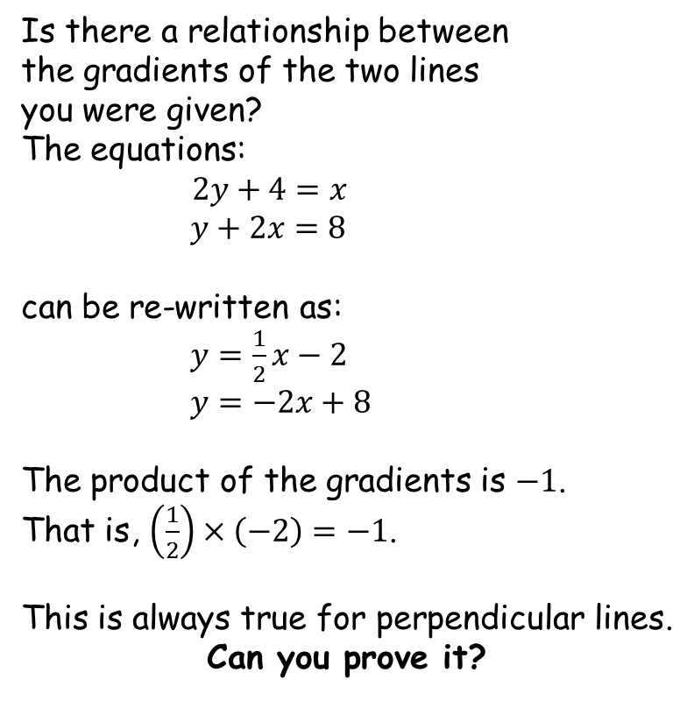
Crossed Lines
Is there a relationship between
the gradients of the two lines
you were given?
The equations:
$2y+4=x$
$y+2x=8$
can be re-written as:
$y=\frac{1}{2}x−2$
$y=−2x+8$
The product of the gradients is $−1$.
That is, $\left(\frac{1}{2}\right)×\left(−2\right)=−1$.
This is always true for perpendicular lines.
Can you prove it?
$$y+2x=8$$
$$2y+4=x$$

Slide 7

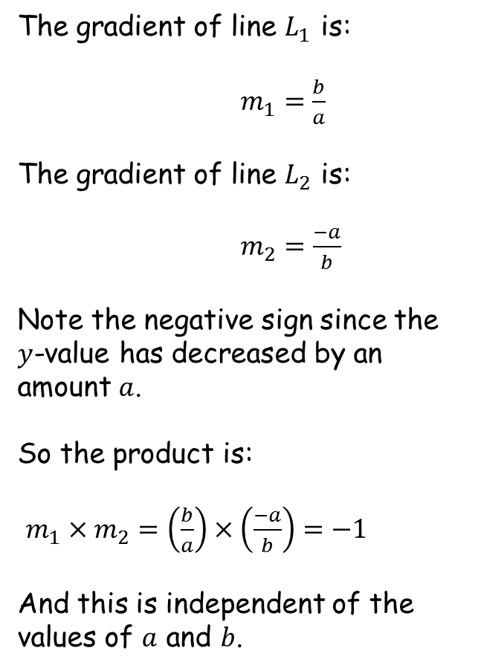





Crossed Lines
The gradient of line $L_{1}$ is:
$m_{1}=\frac{b}{a}$
The gradient of line $L_{2}$ is:
$m_{2}=\frac{−a}{b}$
Note the negative sign since the $y$-value has decreased by an amount $a$.
So the product is:
$m_{1}×m_{2}=\left(\frac{b}{a}\right)×\left(\frac{−a}{b}\right)=−1$
And this is independent of the values of $a$ and $b$.
$$b$$
$$a$$
$$b$$
$$a$$
$$L_{1}$$
$$L_{2}$$

Slide 9
RESOURCES

Slide 10
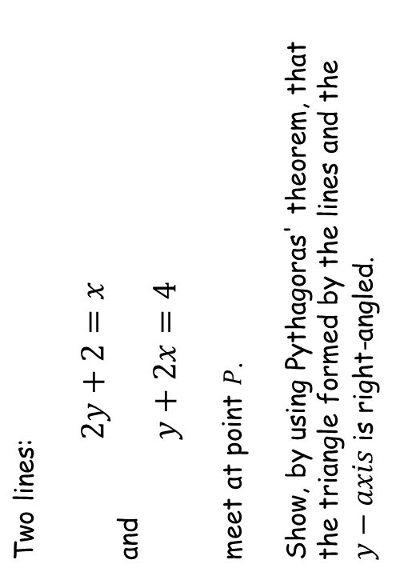


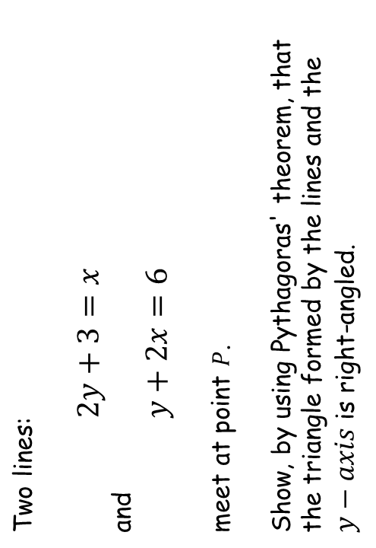
$$P$$
$$P$$
Crossed Lines
Crossed Lines
Two lines:
$2y+2=x$
and
$y+2x=4$
meet at point $P$.
Show, by using Pythagoras' theorem, that the triangle formed by the lines and the $y−axis$ is right-angled.
Two lines:
$2y+3=x$
and
$y+2x=6$
meet at point $P$.
Show, by using Pythagoras' theorem, that the triangle formed by the lines and the $y−axis$ is right-angled.
SIC_25
SIC_25

Slide 11
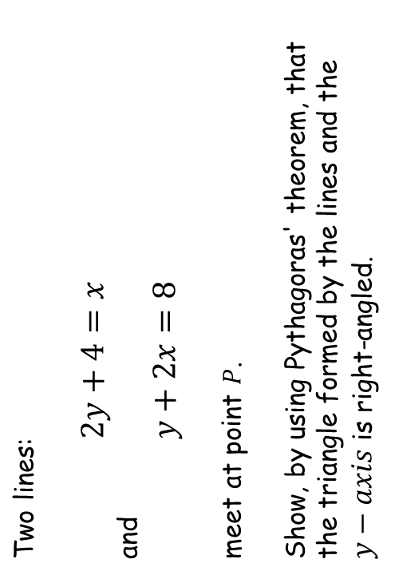
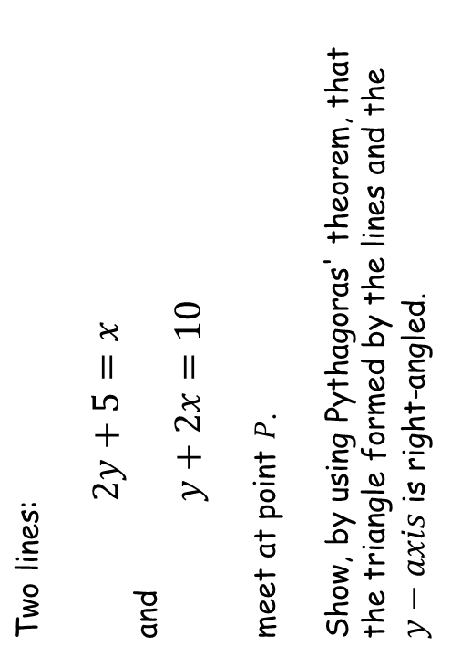
$$P$$
$$P$$
Crossed Lines
Crossed Lines
Two lines:
$2y+4=x$
and
$y+2x=8$
meet at point $P$.
Show, by using Pythagoras' theorem, that the triangle formed by the lines and the $y−axis$ is right-angled.
Two lines:
$2y+5=x$
and
$y+2x=10$
meet at point $P$.
Show, by using Pythagoras' theorem, that the triangle formed by the lines and the $y−axis$ is right-angled.
SIC_25
SIC_25

Slide 12
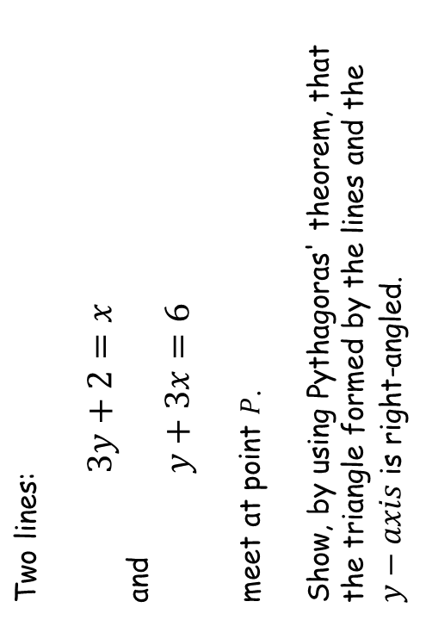
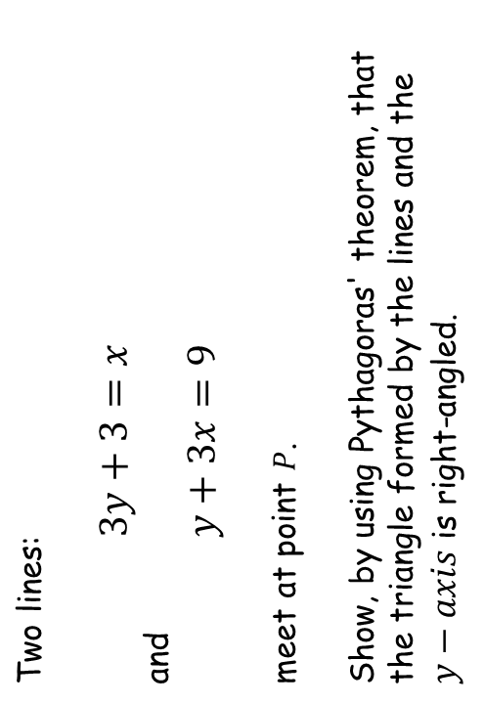
$$P$$
$$P$$
Crossed Lines
Crossed Lines
Two lines:
$3y+2=x$
and
$y+3x=6$
meet at point $P$.
Show, by using Pythagoras' theorem, that the triangle formed by the lines and the $y−axis$ is right-angled.
Two lines:
$3y+3=x$
and
$y+3x=9$
meet at point $P$.
Show, by using Pythagoras' theorem, that the triangle formed by the lines and the $y−axis$ is right-angled.
SIC_25
SIC_25

Slide 13
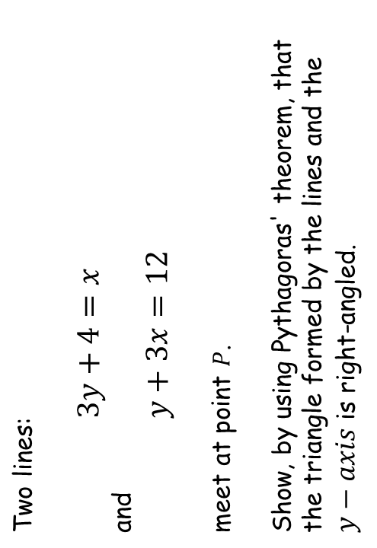
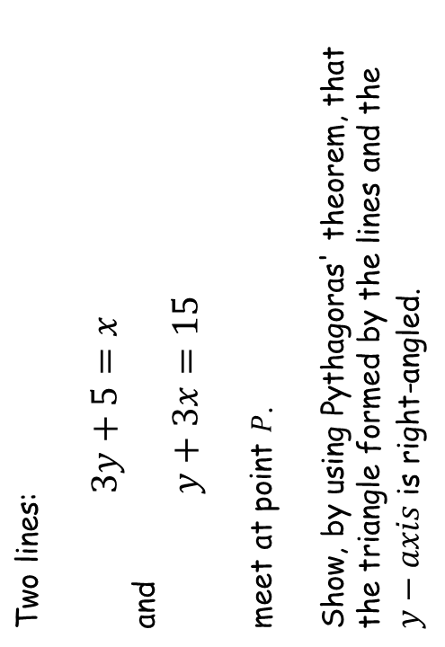
$$P$$
$$P$$
Crossed Lines
Crossed Lines
Two lines:
$3y+4=x$
and
$y+3x=12$
meet at point $P$.
Show, by using Pythagoras' theorem, that the triangle formed by the lines and the $y−axis$ is right-angled.
Two lines:
$3y+5=x$
and
$y+3x=15$
meet at point $P$.
Show, by using Pythagoras' theorem, that the triangle formed by the lines and the $y−axis$ is right-angled.
SIC_25
SIC_25

Slide 14
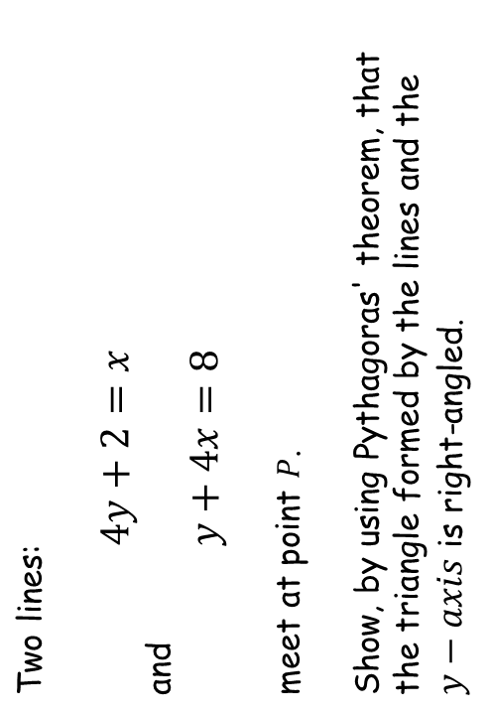
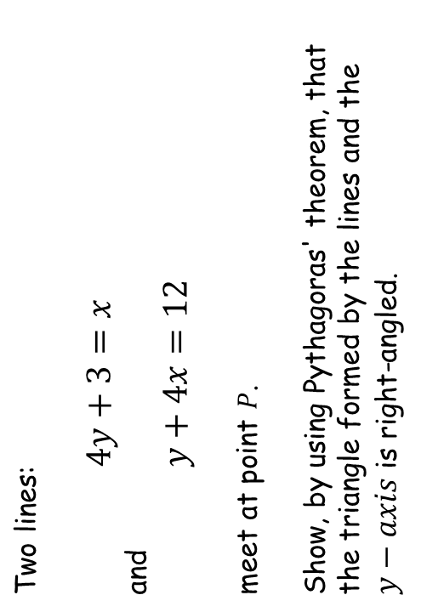
$$P$$
$$P$$
Crossed Lines
Crossed Lines
Two lines:
$4y+2=x$
and
$y+4x=8$
meet at point $P$.
Show, by using Pythagoras' theorem, that the triangle formed by the lines and the $y−axis$ is right-angled.
Two lines:
$4y+3=x$
and
$y+4x=12$
meet at point $P$.
Show, by using Pythagoras' theorem, that the triangle formed by the lines and the $y−axis$ is right-angled.
SIC_25
SIC_25

Slide 15
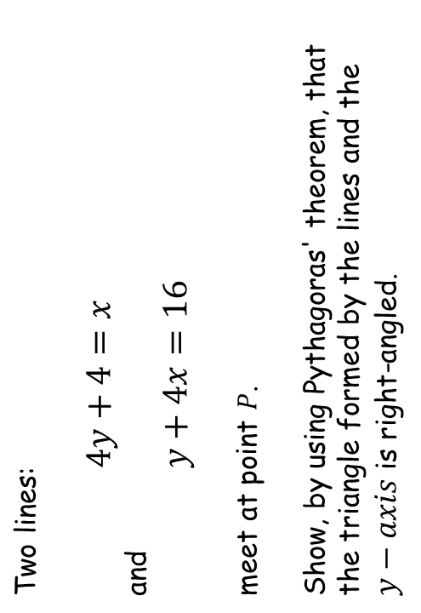
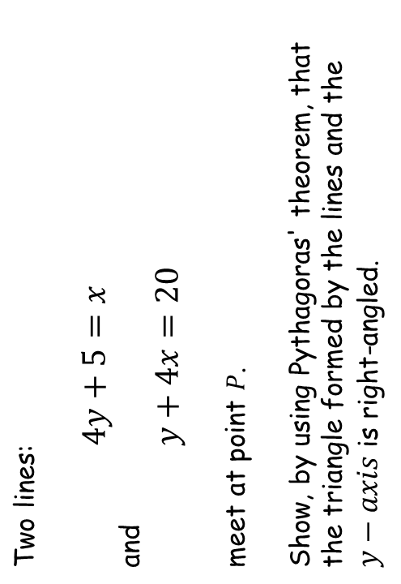
$$P$$
$$P$$
Crossed Lines
Crossed Lines
Two lines:
$4y+4=x$
and
$y+4x=16$
meet at point $P$.
Show, by using Pythagoras' theorem, that the triangle formed by the lines and the $y−axis$ is right-angled.
Two lines:
$4y+5=x$
and
$y+4x=20$
meet at point $P$.
Show, by using Pythagoras' theorem, that the triangle formed by the lines and the $y−axis$ is right-angled.
SIC_25
SIC_25

Slide 16
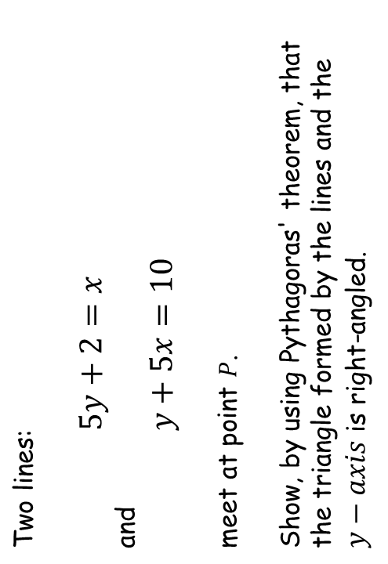
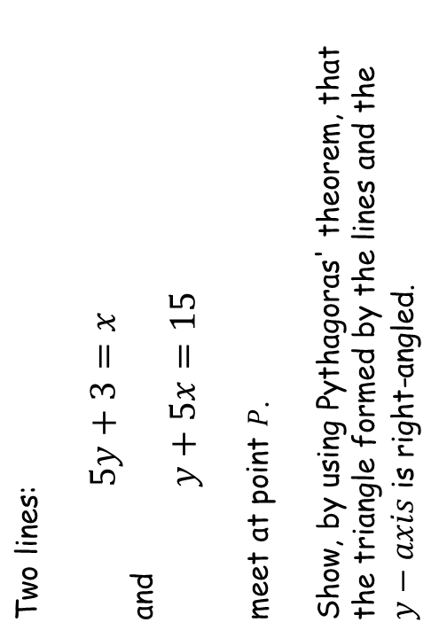
$$P$$
$$P$$
Crossed Lines
Crossed Lines
Two lines:
$5y+2=x$
and
$y+5x=10$
meet at point $P$.
Show, by using Pythagoras' theorem, that the triangle formed by the lines and the $y−axis$ is right-angled.
Two lines:
$5y+3=x$
and
$y+5x=15$
meet at point $P$.
Show, by using Pythagoras' theorem, that the triangle formed by the lines and the $y−axis$ is right-angled.
SIC_25
SIC_25

Slide 17
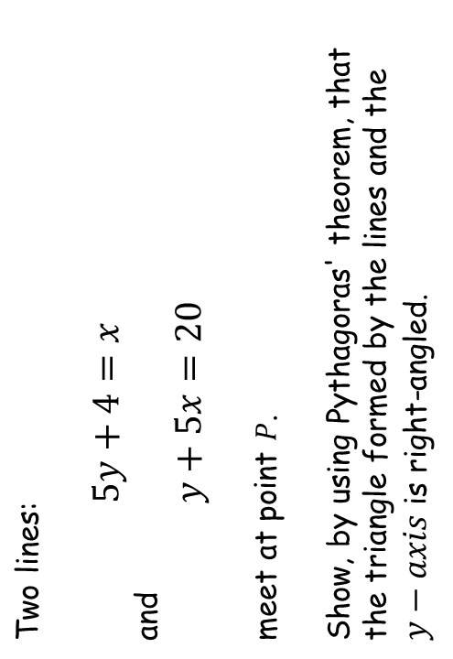
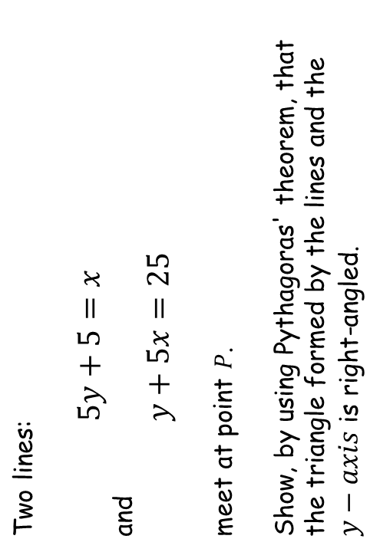
$$P$$
$$P$$
Crossed Lines
Crossed Lines
Two lines:
$5y+4=x$
and
$y+5x=20$
meet at point $P$.
Show, by using Pythagoras' theorem, that the triangle formed by the lines and the $y−axis$ is right-angled.
Two lines:
$5y+5=x$
and
$y+5x=25$
meet at point $P$.
Show, by using Pythagoras' theorem, that the triangle formed by the lines and the $y−axis$ is right-angled.
SIC_25
SIC_25

